Slide 1
MALLA REDDY UNIVERSITY
MR22-1CS0148: DATA MINING
II Year B.Tech. CSE iI - Sem
(MRU-R22)
UNIT-IIi

Slide 2
Data Warehousing and Online Analytical Processing- Data Warehouse: Basic Concepts, Data Warehouse Modeling: Data Cube and OLAP, Data Warehouse Design and Usage, Data Warehouse Implementation, Data Generalization by Attribute-Oriented Induction.

Slide 3
Data Warehouse
A data warehouse is a subject-oriented, integrated, time-variant and non-volatile collection of data in support of management's decision making process.
Subject-Oriented: A data warehouse can be used to analyze a particular subject area. For example, "sales" can be a particular subject.
Integrated: A data warehouse integrates data from multiple data sources. For example, source A and source B may have different ways of identifying a product, but in a data warehouse, there will be only a single way of identifying a product.
Time-Variant: Historical data is kept in a data warehouse. For example, one can retrieve data from 3 months, 6 months, 12 months, or even older data from a data warehouse. This contrasts with a transactions system, where often only the most recent data is kept.
Non-volatile: Once data is in the data warehouse, it will not change. So, historical data in a data warehouse should never be altered.

Slide 4
Differences between Operational Database Systems and Data Warehouses
The major task of online operational database systems is to perform online transaction and query processing. These systems are called online transaction processing (OLTP) systems.
Data warehouse systems, on the other hand, serve users or knowledge workers in the role of data analysis and decision making. Such systems can organize and present data in various formats in order to accommodate the diverse needs of different users. These systems are known as online analytical processing (OLAP) systems.

Slide 5
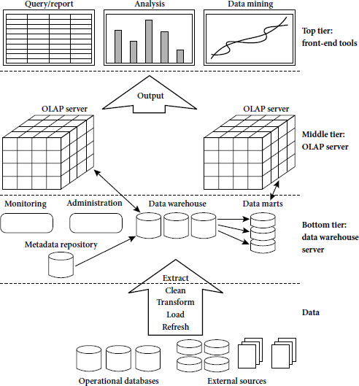
A Three Tier Data Warehouse Architecture:

Slide 6
There are three data warehouse models.
Enterprise Warehouse, Data Mart, and Virtual Warehouse
An enterprise warehouse collects all of the information about subjects spanning the entire organization.
A data mart contains a subset of corporate-wide data that is of value to a specific group of users. The scope is confined to specific selected subjects. For example, a marketing data mart may confine its subjects to customer, item, and sales. The data contained in data marts tend to be summarized.
A virtual warehouse is a set of views over operational databases. For efficient query processing, only some of the possible summary views may be materialized.

Slide 7
Data Cube
A data cube allows data to be modeled and viewed in multiple dimensions. It is defined by dimensions and facts.
In general terms, dimensions are the perspectives or entities with respect to which an organization wants to keep records.
Each dimension may have a table associated with it, called a dimension table, which further describes the dimension. For example, a dimension table for item may contain the attributes item name, brand, and type.
OLAP (online analytical processing) and data warehousing uses multi dimensional databases. It is used to show multiple dimensions of the data to users.
It represents data in the form of data cubes. Data cubes allow to model and view the data from many dimensions and perspectives.

Slide 8
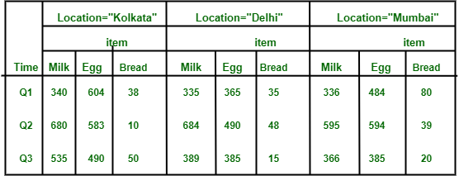
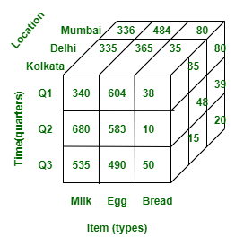
This data can be represented in the form of three dimensions conceptually, which is shown in the image below :

Slide 9
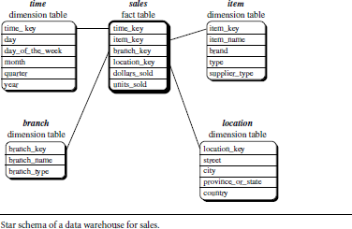
Stars, Snowflakes, and Fact Constellations as schemas for Multidimensional Data Models.
Star schema:
A star schema for All Electronics sales is shown in Figure. Sales are considered along four dimensions, namely,time, item, branch, and location. The schema contains a central fact table for sales that contains keys to each of the four dimensions, along with two measures: dollars sold and units sold.
Star schema: The most common modeling paradigm is the star schema, in which the data warehouse contains (1) a large central table (fact table) containing the bulk of the data, with no redundancy, and (2) a set of smaller attendant tables (dimension tables), one for each dimension. The schema graph resembles a starburst, with the dimension tables displayed in a radial pattern around the central fact table.

Slide 10
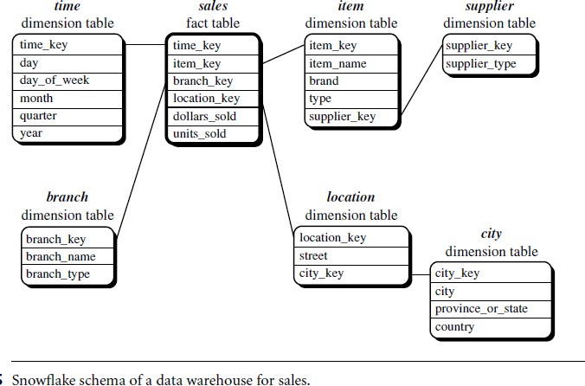
A snowflake schema for AllElectronics sales is given in Figure Here, the sales fact table is identical to that of the star schema in Figure . The main difference between the two schemas is in the definition of dimension tables.
The single dimension table for item in the star schema is normalized in the snowflake schema, resulting in new item and supplier tables.

Slide 11
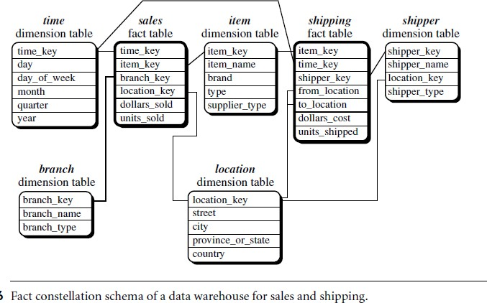
Fact constellation.
A fact constellation schema is shown in Figure. This schema specifies two fact tables, sales and shipping. The sales table definition is identical to that of the star schema . The shipping table has five dimensions, or keys: item key, time key, shipper key, from location, and to location, and two measures: dollars cost and units shipped.
A fact constellation schema allows dimension tables to be shared between fact tables. For example, the dimensions tables for time, item, and location are shared between both the sales and shipping fact tables.

Slide 12
OLAP(Online analytical Processing):
OLAP is an approach to answering multi-dimensional analytical (MDA) queries swiftly.
OLAP is part of the broader category of business intelligence, which also encompasses relational database, report writing and data mining.
OLAP tools enable users to analyze multidimensional data interactively from multiple perspectives.
OLAP consists of three basic analytical operations:
Consolidation (Roll-Up)
Drill-Down
Slicing And Dicing
Pivot (rotate)

Slide 13
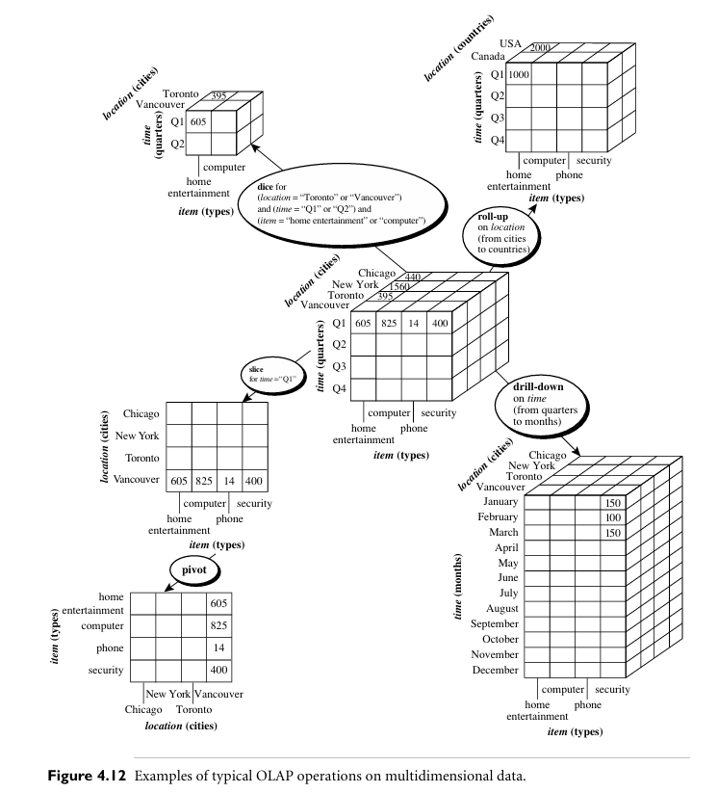

Slide 14
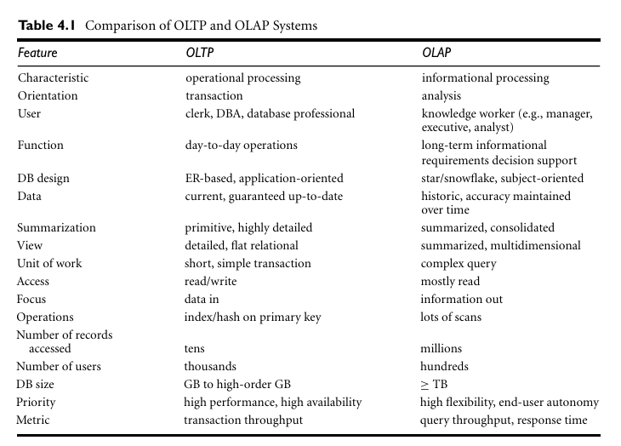

Slide 15
Data Warehouse Design Process and usage
A data warehouse can be built using a top-down approach, a bottom-up approach, or a combination of both.
The top-down approach starts with the overall design and planning. It is useful in cases where the technology is mature and well known, and where the business problems that must be solved are clear and well understood.
The bottom-up approach starts with experiments and prototypes. This is useful in the early stage of business modeling and technology development. It allows an organization to move forward at considerably less expense and to evaluate the benefits of the technology before making significant commitments.
In the combined approach, an organization can exploit the planned and strategic nature of the top-down approach while retaining the rapid implementation and opportunistic application of the bottom-up approach.

Slide 16
Implementation of A Data Warehouse
Data warehouses contain huge volumes of data. OLAP servers demand that decision support queries be answered in the order of seconds. Therefore, it is crucial for data warehouse systems to support highly efficient cube computation techniques, access methods, and query processing techniques.
Efficient Data Cube Computation:
Efficient data cube computation is crucial for quickly analyzing and summarizing large datasets. A data cube is a multi-dimensional array that represents pre-aggregated measures for various combinations of dimensions.
Accessing Methods:
Accessing data quickly from a data warehouse is crucial for supporting fast and efficient decision-making processes. Several methods and techniques are employed to optimize data access in a data warehouse environment. Indexing is a common strategy
Query Processing Techniques(Efficient Processing of OLAP Queries):
OLAP (Online Analytical Processing) queries involve complex analysis of large volumes of data to provide insights and support decision-making. Efficient processing of OLAP queries is crucial for delivering timely and responsive results.

Slide 17
basic approaches for Data generalization
Data Generalization
Data generalization is a crucial step in the data analysis process, as it allows us to make sense of large and complex datasets by identifying patterns and trends that may not be immediately apparent. By simplifying the data, we can more easily identify relationships, classify data points, and draw conclusions about the underlying data.
There are a number of different approaches that can be used to generalize data, each with its own strengths and limitations.
Basic Approaches of Data Generalization:
There are two main approaches to data generalization − the data cube approach and attribute orientation induction.

